Slide 1

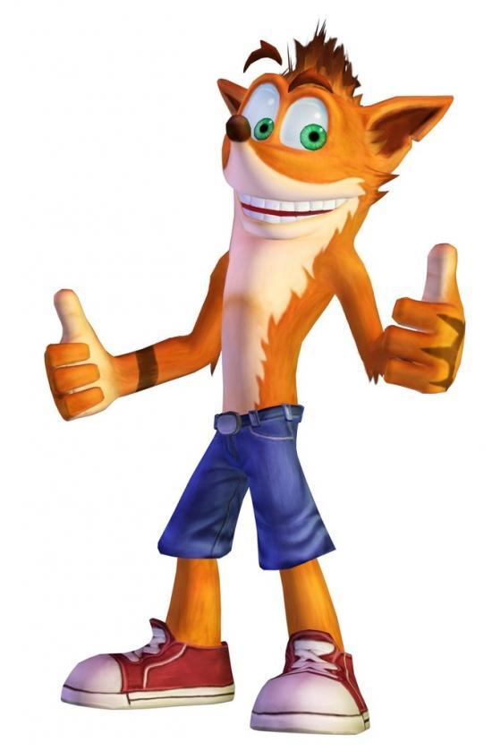
Crash on Titan
Victor Breda
Paula-Alexandra Gitu
Tobias Mersch
Joep Muijrers
Valentin Ringlet
Roy Withaar
Project 1.2, Presentation Second Phase

Slide 2


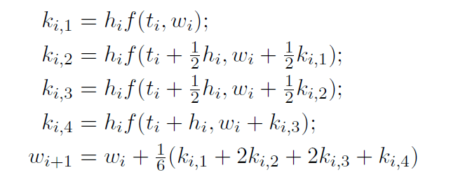
Solar System Improvement
Phase 1:
Euler’s method
Not reaching Titan
Improvements:
Implemented Runge-Kutta Fourth Order
Method for reaching Titan
Notes:
Valentin or Victor ?

Slide 3
Controllers for Landing
Open-Loop Controller
the control action performed = independent of the “process output
Example: heater which heats for a given time
For the landing:
constant thrust
To nearly completely counter all other forces
Notes:
Open-Loop Controller
In an open-Loop Controller, the control action performed is independent of the “process output”, which is the variable being controlled
Example: heater which heats for a given time, without measuring the temperature of the room
How it works for the landing:
The landing module uses a constant thrust at every moment, which would have to be nearly equal in norm to the gravity
Does not take into account anything, so can not counter the wind

Slide 4
Controllers for Landing
Feedback Controller
Opposite of the open-loop controller
For the landing:
Correct the x-position
Done by tilting the landing module
Correct the y-position
Take into account gravity (and optionally also wind)
Determine if we use the thruster
Notes:
Feedback Controller
Opposite of the open-loop controller, so can take into account all given variables, which are the x- and y-position, the x- and y-velocity, as well as the angle
In this case, that means:
Correct the x-position by modifying the angle of the landing module in order to make the main thruster exert a partially horizontal force
Determine whether we need to use the thruster or not in order to land safely

Slide 5
Wind model
Constant max wind acceleration
Wind
In random direction
Of random force, up to max
Notes:
In our model, we have a constant setting the maximum acceleration caused by the wind
The generated wind is generated in a random direction and of a randomized intensity between 0 and 1.
We read that the strongest wind measured during the landing of the probe from NASA was 120 m/s, but given that our thruster is set to have a maximum strength of 2500 N, we couldn’t make the maximum wind 120 m/s *(SAY THIS ONLY IF THEY ASK !!! thruster force in Newtons still needs to be divided by the weight of the landing module, which we set to 800 kgs)*

Slide 6
Experiments
Made experiments by modifying parameters, then measured the result
See Excel sheet
Notes:
Made experiments by modifying parameters one at a time, then measured the x- and y- positions and velocities, as well as the angle and the time the landing module took to land
See Excel sheet *show the Excel sheet to them*

Slide 7
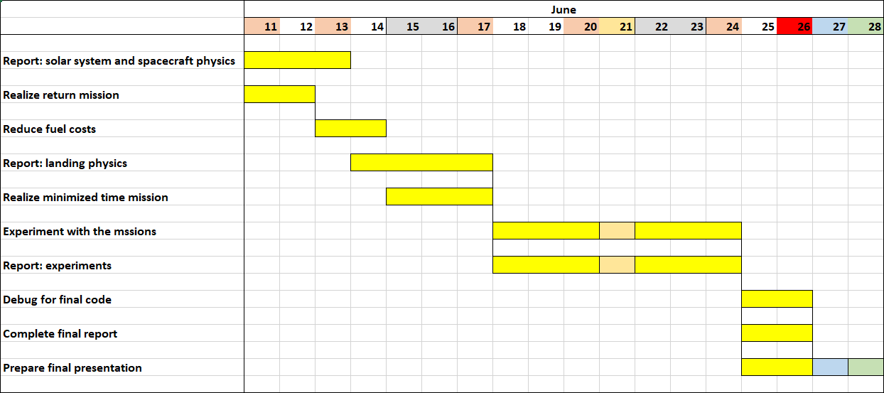
Phase 3 Schedule
Notes:
Main tasks:
Realizing a return mission from the orbit of the Titan *(ask if it is from the orbit or from the ground of Titan)*
Reduce mission costs by reducing fuel consumption of the travel
Idea: gravitation assist, problem: how to do that, we need to find formulas for it
Search ways to improve the time taken for the travel *(ask if it concerns only the time of travel or also the time of landing)*
Write report
Other tasks:
do experiments with the mission and find which parameters we could do experiments with

Slide 8
Demo
Show demo
Notes:
*Show demo by running program on someone’s computer*

Slide 9


Thanks for your attention !

